Slide 1
2-D Arrays
Overview
Why do we need Multi-dimensional array
2-D array declaration
Accessing elements of a 2-D array
Declaration using Initializer List
Examples using 2-D array

Slide 2
Why Multi-Dimensional Arrays?
The same reason that necessitated the introduction of 1-D array can also be extended to Multi-dimensional Array.
For example, to store the grades of (30) students, each of which is taking a number of courses (5 say), we would either use 30 1-D arrays, one for each student or 5 1-D arrays, one for each course
Multi-Dimensional array allows us to handle all these using a single identifier.
2-Dimensional array is the most commonly used multi-dimensional arrays.
Other multi-dimensional arrays are also possible. For example, the students grades representation example above can be extended to cover several sections by introducing another dimension.
Java allows the handling of array of any dimension in a consistent manner.

Slide 3
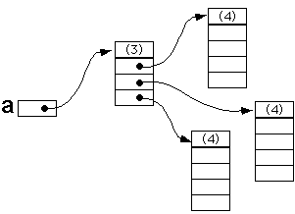
Multi-Dimensional Array Declaration
A two-dimensional array is declared in a similar manner to 1-D array but with the addition of one more bracket as in the following example;
int [][] a = new int[3][4];
Although it is convenient to think of a 2-D array as a table as shown above, in reality, a is simply an array of arrays.
The following figure shows how a is actually represented.
a | 0 | 1 | 2 | 3
0
1
2

Slide 4


Multi-Dimensional Array Declaration
The declaration in the previous slide is infact a three-step process.
Creation of the reference a:
int[][] a;
Creation of the array of references to arrays
a = new int[3][];
Creation of the individual arrays
for (int i=0; i<a.length; i++)
a[i] = new int[4];

Slide 5
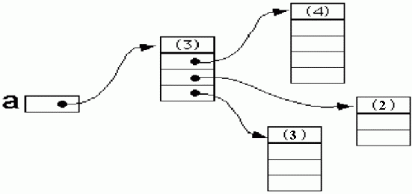
Multi-Dimensional Array Declaration
From the declaration of 2-D array above, we can observe that a.length gives the length of the array referenced by a – 3 in this example or the number of rows of the array.
To get the number of columns in a, we have to ask how many elements there are in a row; this number would be given by a[0].length, or equivalently by a[1].length or a[2].length
In fact, because the columns are treated individually, they do not need to all be of the same size.
For example, we could have the following:
a[0] = new int[4];
a[1] = new int[2];
a[2] = new int[3];

Slide 6
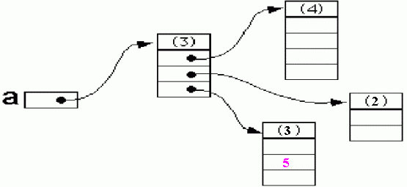
Accessing individual elements
We can access individual elements of a 2-D array by specifying both the row and column index in the form: a[i][j]
where i is the row index and j is the column index.
Keep in mind, of course, that both rows and columns are numbered starting from zero. For example, the statement:
a[2][1] = 5;
assigns 5 to the cell at row 3 column 2.

Slide 7
Declaration Using Initializer List
Similar to 1-D array, a two-dimensional array can be created as a list of array initializers, one for each row in the array, as shown by the following:
int[][] a = { { 1, 0, 12, -1 },
{ 7, -3, 2, 5 },
{ -5, -2, 2, 9 } };
To realize the above, the compiler has to do the following:
int[][] a = new int[3][];
a[0] = new int[4];
a[0][0] = 1; a[0][1] = 0; ...
a[1] = new int[4];
a[1][0] = 7; a[1][1] = -3; . . .
. . .

Slide 8
Examples
The following example fills each cell in a 2-D array with the sum of its row and column indices.
class FillTwoDArray {
public static void main (String[] args) {
int[][] a = new int[4][5];
for (int row=0; row < a.length; row++)
for (int col=0; col < a[0].length; col++)
a[row][col] = row+col;
}
}
2-D array can be easily extended to any dimension. For example, to declare a 3-Dimensional array, we need only add one more bracket as in:
int [][][] threeDArray = new int [10][20][15];
The next example reads two 2-D arrays, compute their sums and print the result.

Slide 9
Examples (Cont’d)
import java.io.*;
public class Matrix {
static BufferedReader stdin = new BufferedReader( new InputStreamReader(System.in));
public static void main(String[] args) throws IOException {
int row, column;
System.out.print("Enter number of rows: ");
row = Integer.parseInt(stdin.readLine());
System.out.print("Enter number of columns: ");
column = Integer.parseInt(stdin.readLine());
double[][] a = createArray(row, column);
double[][] b = createArray(row, column);
double[][] c = sum2DArray(a, b);
System.out.println("The sum of the two arrays is");
print2DArray(c);
}
static double[][] createArray(int row, int col) throws IOException {
double[][] array = new double[row][col];
System.out.println("Enter elements for a "+row+" by "+col+" matrix");
for (int i=0; i<row; i++)
for (int j=0; j<col; j++)
array[i][j] = Double.parseDouble(stdin.readLine());
return array;
}

Slide 10
Examples (Cont’d)
static double[][] sum2DArray(double[][] a, double[][] b) {
int row = a.length;
int col = a[0].length;
double[][] c = new double[row][col];
for (int i=0; i<row; i++)
for (int j=0; j<col; j++)
c[i][j] = a[i][j] + b[i][j];
return c;
}
static void print2DArray(double[][] a) {
int row = a.length;
int col = a[0].length;
for (int i=0; i<row; i++) {
for (int j=0; j<col; j++)
System.out.print(a[i][j]+ "\t");
System.out.println();
}
}
}

